Slide 1
5 Question Zoom Quiz
PLEASE choose "I don't know" instead of guessing because guessing the right answers disrupts this process
The goal isn't to be right. We actually ignore correct answers and only focus on what people get wrong to know where to spend more time explaining.
Once the quiz reaches quorum we'll start.
Notes:
PLEASE choose "I don't know" instead of guessing because guessing the right answers disrupts this process
If you think you'll get the answers wrong please take the quiz. We actually ignore correct answers and only focus on what people get wrong.

Slide 2
Chapter 3 – Storage and Retrieval
Designing Data‑Intensive Applications
Lessons Learned
Notes:
Welcome, everyone!
Over the next half hour, we’re going to unpack Chapter 3 of Martin Kleppmann’s Designing Data‑Intensive Applications.
This chapter sits at the very heart of the book,
because it explains how a database actually puts bytes on disk—
and more importantly, how it gets them back out again.
We’ll explore the two dominant families of storage engines:
Log‑structured, and
Update‑in‑place
We’ll see how these two models power real-world structures like:
LSM‑trees, and
B‑trees
Then we’ll shift focus and contrast two kinds of workloads:
Transactional (OLTP)
Analytic (OLAP)
Along the way, we’ll dissect every diagram in the chapter,
so you can actually see how things like:
Compaction
Sparse indexes
Page splits, and
Columnar compression
…work in practice.
Feel free to interrupt with clarifying questions—
but we’ll also have a dedicated Q&A section at the end.
Let’s jump in!

Slide 3
Key Concepts Overview (1/2)
𝗦𝘁𝗼𝗿𝗮𝗴𝗲 𝗘𝗻𝗴𝗶𝗻𝗲: component responsible for persisting & retrieving bytes.
Two families: 𝗟𝗼𝗴‑𝘀𝘁𝗿𝘂𝗰𝘁𝘂𝗿𝗲𝗱 (append‑only) vs. 𝗨𝗽𝗱𝗮𝘁𝗲‑𝗶𝗻‑𝗽𝗹𝗮𝗰𝗲 (page‑oriented).
𝗜𝗻𝗱𝗲𝘅: auxiliary data structure that maps a search key → location of the value.
Critical trade‑off: more indexes ⇒ faster reads 𝗯𝘂𝘁 slower writes.
All designs ultimately fight disk latency: seek time, bandwidth & write amplification.
Notes:
This slide seeds the mental model we’ll use for the rest of the talk.
Whenever you hear the term storage engine, think of the layer that accepts a stream of writes from higher‑level database logic and turns those writes into durable on‑disk structures.
The chapter splits engines into two broad tribes:
𝗟𝗼𝗴‑𝘀𝘁𝗿𝘂𝗰𝘁𝘂𝗿𝗲𝗱 𝗲𝗻𝗴𝗶𝗻𝗲𝘀 only ever append to files. They later clean up with background compaction. Examples: Bitcask in Riak, LevelDB, RocksDB, Cassandra, HBase, and Lucene.
The contrasting tribe, dating back to the 1970s, is 𝘂𝗽𝗱𝗮𝘁𝗲‑𝗶𝗻‑𝗽𝗹𝗮𝗰𝗲. These engines treat the disk as an array of fixed-size pages—typically 4 KB—and overwrite the page that contains a record. B‑trees dominate here.
Both tribes rely on 𝗶𝗻𝗱𝗲𝘅𝗲𝘀.
The index costs extra I/O on every write, but without it, every read would be an O(n) full scan.
The rest of the chapter is a tour of concrete index structures, so keep this classification top of mind.

Slide 4
Key Concepts Overview (2/2)
𝗪𝗼𝗿𝗸𝗹𝗼𝗮𝗱 𝗦𝗵𝗮𝗽𝗲𝘀: 𝗢𝗟𝗧𝗣 (many small reads/writes) ≠ 𝗢𝗟𝗔𝗣 (few, heavy scans)
𝗦𝘁𝗼𝗿𝗮𝗴𝗲 𝗽𝗮𝘁𝘁𝗲𝗿𝗻𝘀 follow workload: seek‑optimised pages vs. bandwidth‑optimised columns
𝗖𝗼𝗺𝗽𝗮𝗰𝘁𝗶𝗼𝗻 & 𝗠𝗲𝗿𝗴𝗲: background tasks that make append‑only logs economical
𝗪𝗿𝗶𝘁𝗲 𝗔𝗺𝗽𝗹𝗶𝗳𝗶𝗰𝗮𝘁𝗶𝗼𝗻: 1 logical write → many physical writes; enemy of throughput & SSD life
𝗖𝗼𝗻𝗰𝘂𝗿𝗿𝗲𝗻𝗰𝘆 & crash‑recovery requirements shape on‑disk design as much as performance
Notes:
Engineers often lump all “database traffic” together, but Chapter 3 stresses that there are two radically different workload shapes.
𝗢𝗟𝗧𝗣 (Online Transaction Processing) backs user-facing applications—think updating an order, liking a photo, or writing a message.
Latency is critical, but each transaction touches only a handful of rows.
Indexes that minimise seek time dominate here.
𝗢𝗟𝗔𝗣 (Online Analytical Processing), by contrast, is run by analysts.
A single query may scan billions of rows, but a handful of analysts can tolerate seconds of latency if they get the answer in one shot.
Here, the bottleneck is not seek time but 𝗯𝗮𝗻𝗱𝘄𝗶𝗱𝘁𝗵.
Columnar storage, heavy compression, and vectorised execution shine in this domain.
You’ll hear the terms compaction, merge, and write amplification repeatedly:
𝗖𝗼𝗺𝗽𝗮𝗰𝘁𝗶𝗼𝗻 rewrites and deduplicates log segments so they don’t grow forever.
𝗠𝗲𝗿𝗴𝗲 applies the same idea to sorted runs.
Every physical rewrite increases 𝘄𝗿𝗶𝘁𝗲 𝗮𝗺𝗽𝗹𝗶𝗳𝗶𝗰𝗮𝘁𝗶𝗼𝗻, which steals bandwidth and wears out SSD flash cells.
Good designs balance that cost against read efficiency.
Finally, durability and multi-threaded (aka concurrent) access impose additional constraints:
𝗪𝗿𝗶𝘁𝗲-𝗮𝗵𝗲𝗮𝗱 𝗹𝗼𝗴𝘀, 𝗰𝗼𝗽𝘆-𝗼𝗻-𝘄𝗿𝗶𝘁𝗲 pages, and similar mechanisms are often essential.
Keep these non-functional constraints in mind as we deep-dive.

Slide 5
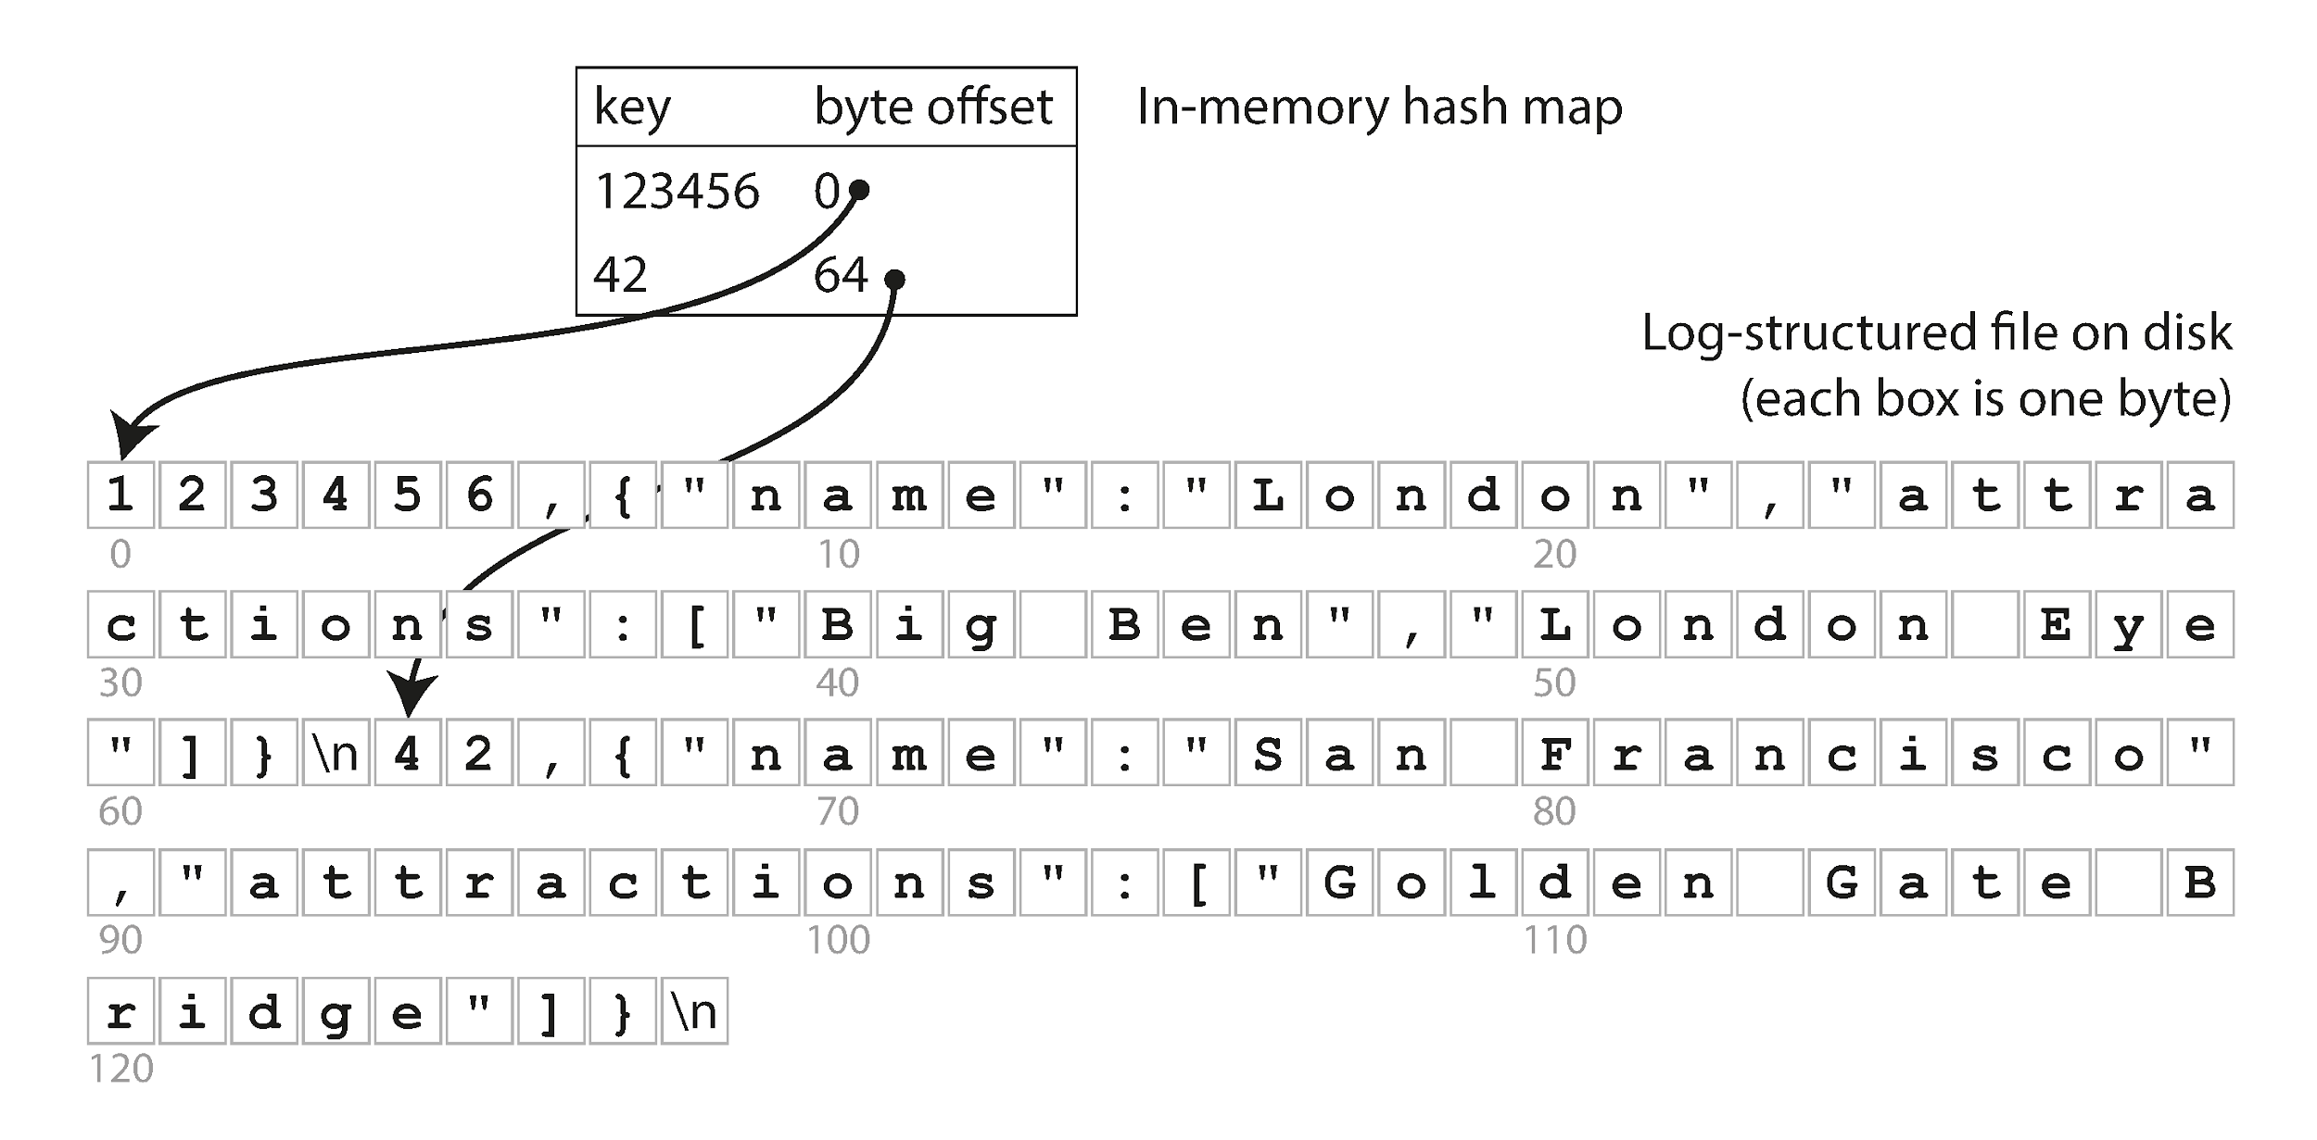
Append‑Only Log with Hash Index Figure 3‑1
{
"123456": {
"name": "London",
"attractions": [
"Big Ben",
"London Eye"
]
},
"42": {
"name": "San Francisco",
"attractions": [
"Golden Gate Bridge"
]
}
}
Notes:
Checkout the table labeled in-memory hash map. This is an index for locating keys saved to the log on disk.
Key 123456 starts at byte offset 0 which is the first byte in the log as seen in the diagram.
Key 42 starts at byte offset 64 which is the 65th byte (considering zero-based index) in the log. This is what Bitcask storage engine in Riak does, and similar to how other log based storage systems reference data (Cassandra, LevelDB, MongoDB..etc)
Seems strange at first to use a log file for a database, but the index makes this fast because: - we do a constant time O(1) read from the hashmap to find the offset of the key
- and then another constant time O(1) disk seek directly to the byte offset in the log file.
So even though all data is stored in one big log, the index we have with the byte offsets makes this very fast.
If that part of the log file is already in the filesystem cache, a read doesn’t require any disk I/O at all!
This allows for high-performance reads and writes. Especially when all the keys fit in the available RAM. This is a reasonable trade off since the keys can be much smaller than the values and the values are stored on disk not memory.

Slide 6
Append‑Only Log with Hash Index
Simplest KV store: append "key,value" lines to a log file.
In‑memory hash map → byte offset gives O(1) look‑ups.
Figure 3‑1 shows CSV‑like log & map; updates just append.
Strengths: blazing‑fast sequential writes; trivial concurrency; easy crash‑recovery.
Weaknesses: hash table must fit in RAM; poor range queries.
Notes:
Let’s ground these ideas in the Bash prototype from the book.
Every db_set call appends a key,value line.
A db_get just does a grep and tail to find the last occurrence.
Of course, production systems don’t use shell scripts—but Bitcask, the default engine inside Riak, implements essentially the same design, just in C and Erlang.
The central optimisation is an 𝗶𝗻‑𝗺𝗲𝗺𝗼𝗿𝘆 𝗵𝗮𝘀𝗵 𝘁𝗮𝗯𝗹𝗲 that maps key → offset.
On a read, we seek directly to the value with a single disk jump—which is still fast, even on spinning rust.
Because the log is append‑only, the write path is just a single write() syscall:
No read‑modify‑write cycle
No page splits
Little or no locking
Failures are simple to handle:
Either the append made it to the end of the file—or it didn’t.
Partial lines are just discarded on startup using a checksum.
But you can already see the cracks in this design:
If your key space is huge, you can’t afford to pin the whole hash table in memory.
If you need to scan keys in order, the random hash order kills you.
That motivates our next refinement.

Slide 7
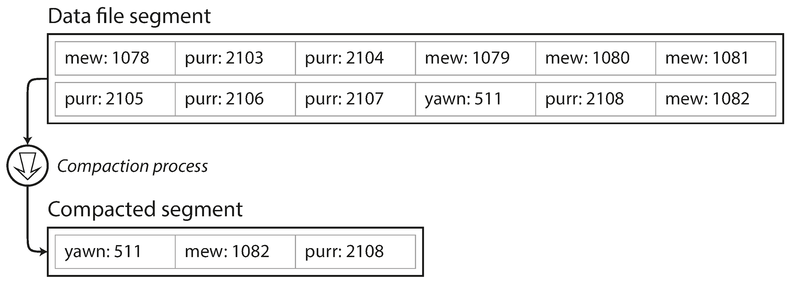
Compaction Figure 3-2
Notes:
You’re looking at the state of a NoSQL database stored on disk.
The data here represents how many likes three different cat videos have.
Because it’s an append-only system, even if we’re updating an existing key,
we still append the new value to the end of the log.
So when the “meow” video gets another like,
it creates a new log entry—not an in-place update.
This leads to duplicate log entries, with outdated values still hanging around.
The in-memory hashmap only points to the byte offset of the most recent entry for each key.
To avoid wasting space, these systems use a process called compaction.
Compaction means:
Throwing away duplicates
Keeping only the most recent value for each key
You can see this in the diagram—we end up with a cleaner, compacted log.
The order of keys in the resulting compacted log is non-deterministic, but the index is updated to contain the exact offs for O(1) look up
If a key is deleted, it still gets a new log entry appended—
but that entry is a special flag called a tombstone.
The tombstone tells the system to exclude that key from future reads and from the compacted log.
So effectively, it’s deleted during compaction.

Slide 8
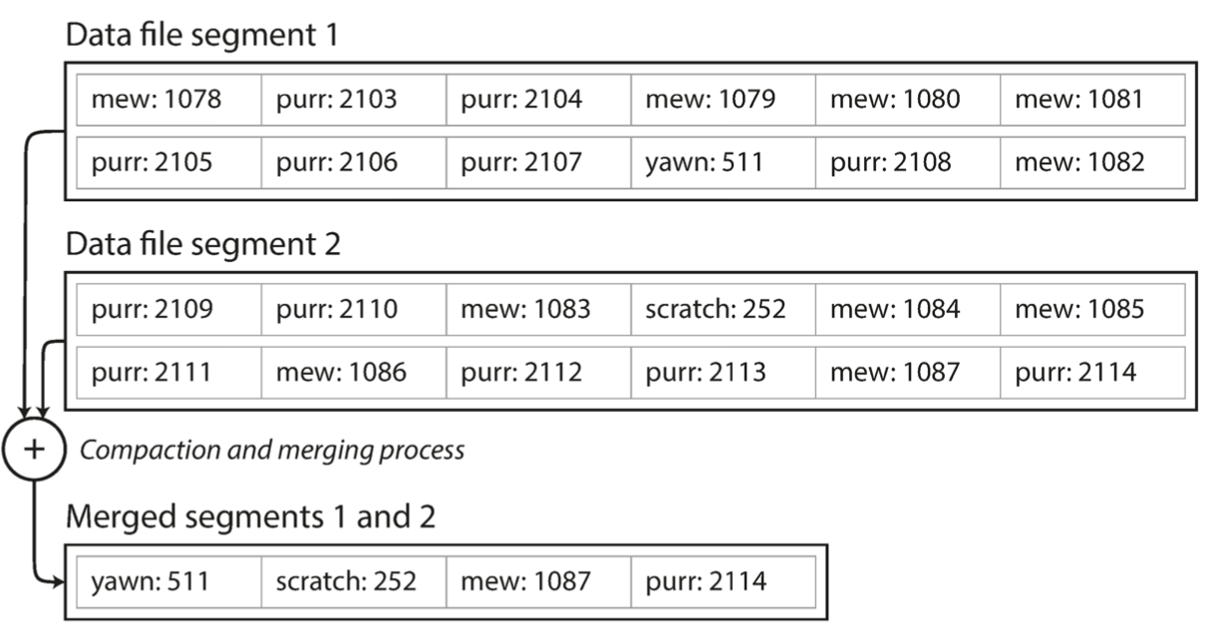
Segment Merging Figure 3-3
Notes:
Since compaction often shrinks segments significantly—
especially if keys are overwritten several times within a segment—
we can merge multiple segments during compaction.
Segments are never modified after they’re written,
so the merged segment is written to a new file.
This merging and compaction happens in a background thread.
While it runs, we can continue serving reads and writes as normal using the old segment files.
Once merging is complete:
We switch read requests to use the new merged segment
Then we delete the old segments—clean and simple
This pattern keeps performance high while managing space efficiently. If a key was updated during this compaction & merging process
It would just append to the latest active segment which is not related to the ones being compacted
Later, future compaction will consolidate that updated key

Slide 9
Compaction & Segment Merging
Log grows without bound → split into fixed‑size segments.
Background process discards overwritten keys (tombstones), writes compacted segment.
Figures 3‑2 & 3‑3 illustrate compaction + merge steps.
Immutable segments enable parallel reads & simplify crash handling.
Space is reclaimed, and hash maps only track active segments.
Notes:
Quick overview (read slide) Remember, each segment has its own in-memory hash table, mapping keys to file offsets. In
order to find the value for a key, we first check the most recent segment’s hash map;
if the key is not present we check the second-most-recent segment, and so on. The
merging process keeps the number of segments small, so lookups don’t need to check
many hash maps.
In production, you’ll tune:
Segment size
Compaction trigger
Merge fan‑out
…to balance write amplification against space usage and read amplification.

Slide 10
Design Trade‑offs of Hash‑Indexed Logs
RAM‑bounded: index lives entirely in memory ⇒ not viable for billions of keys.
Deletions don't free up space immediately, they become tombstone records that compaction must honor later.
Range scans require per‑key lookup → O(n) round‑trips.
Ideal for workloads with few keys & high update rates (counters, sessions, ephemeral caches).
Sets the stage for Sorted String Tables (SSTables).
Notes:
Before we leave Bitcask behind, we need to be honest about its limitations.
First: The in‑memory hash index puts a hard upper bound on key cardinality (aka how many keys you can have).
If your keys are 32‑byte UUIDs, a billion keys would require tens of gigabytes of pointer‑rich hash structures—
→ completely unrealistic for a single node.
Second: Deletes are logical, not physical.
We append a tombstone, and rely on compaction to clean up.
If compaction falls behind, you can run out of disk space.
Third: There’s a complete lack of ordering.
Hash tables scramble their keys, so there’s no efficient way to ask for:
→ all counters between kitty00000 and kitty99999.
But—within the right workload envelope, those warts disappear.
A Bitcask‑style engine is almost unbeatable for:
High-throughput
Low-latency writes
When the key set fits in RAM
Use cases like:
Ephemeral caches
Per-URL hit counters
Session stores
But once you need range queries, or support for many more keys,
we need a new strategy—
→ Enter SSTables and the LSM‑tree.

Slide 11
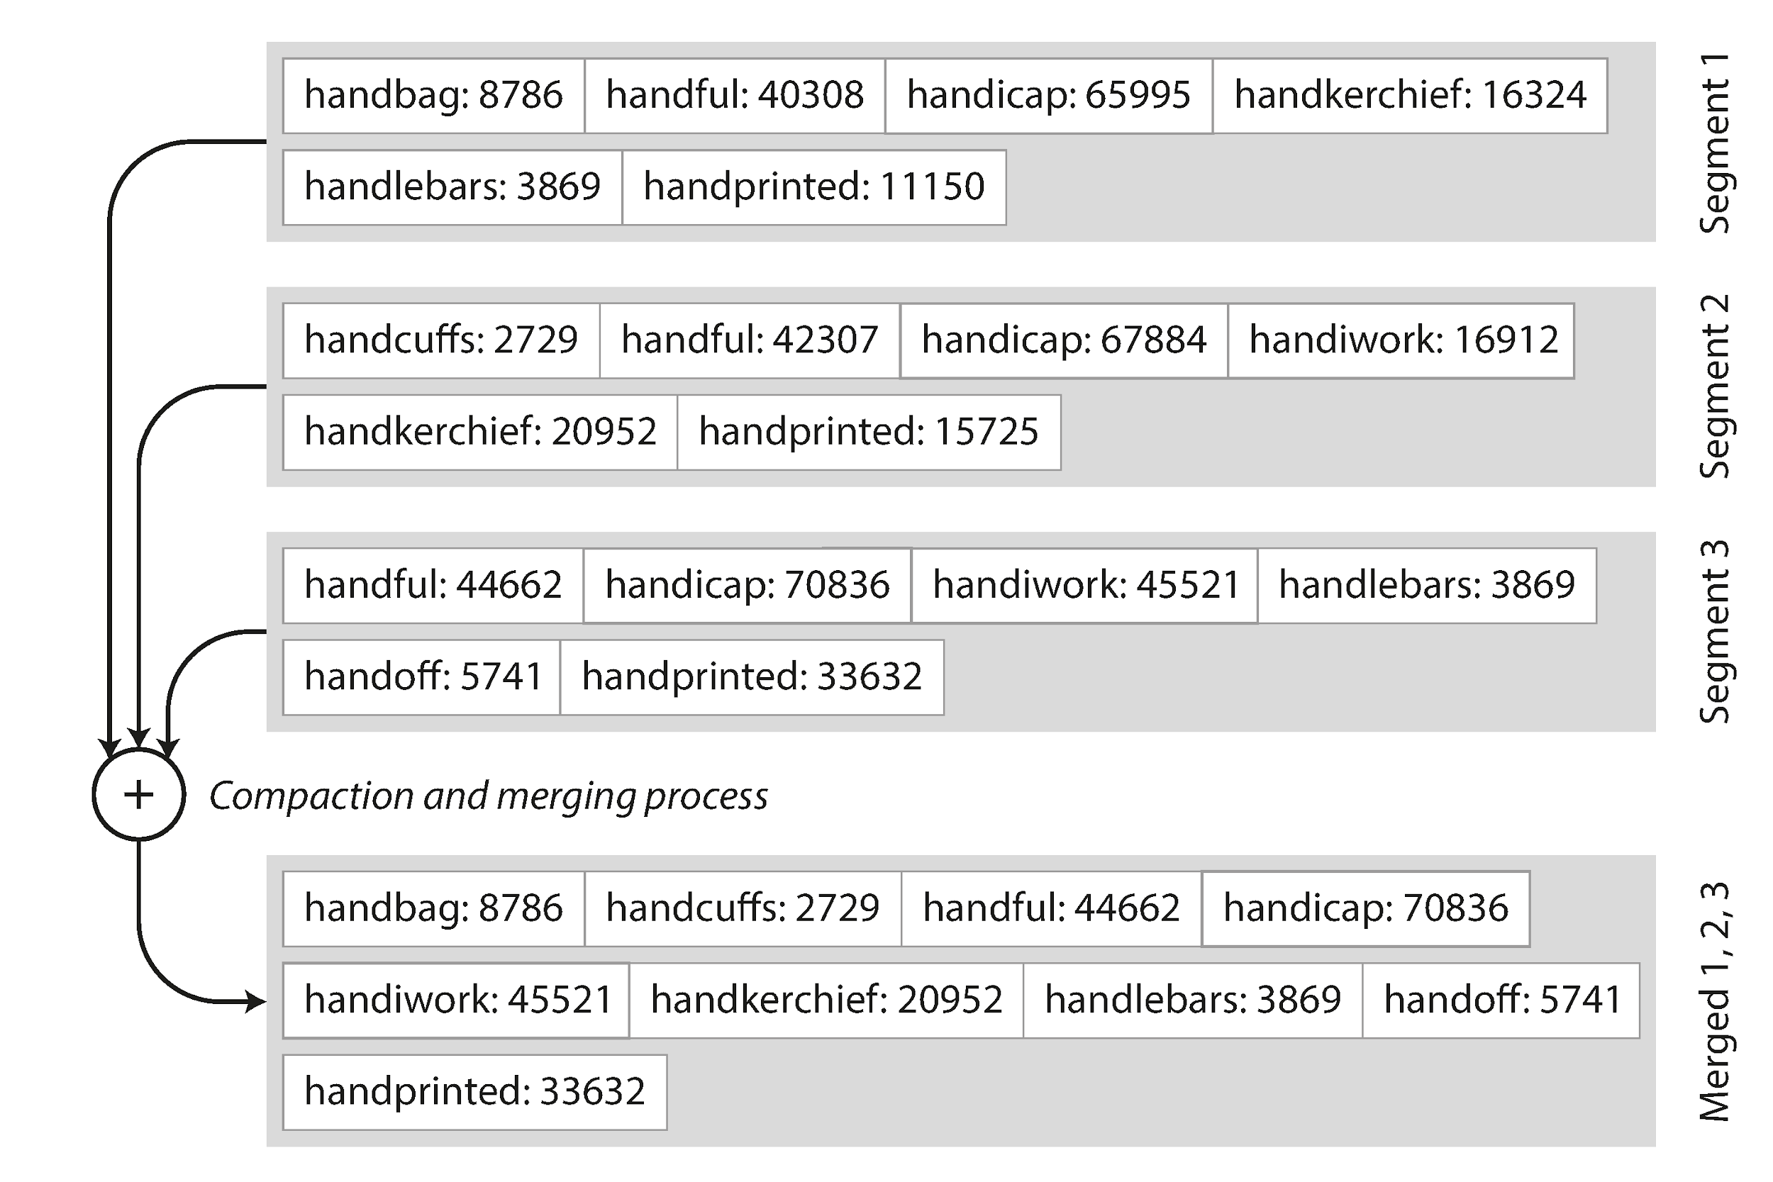
From Logs to Sorted String Tables (SSTables) Figure 3-4
Notes:
We fix lack of ordering in the previous example by requiring that every segment be written in sorted order.
But remember the benefit of append only log is that writes are constant time O(1), we just add it to the end of the log. So we have a big question here: How do we introduce sorting without killing append performance? ***WAIT FOR AUDIENCE ANSWER***
Simple:
We first buffer writes in an in‑memory balanced tree called the memtable.
When the memtable grows to a few megabytes, we flush it to disk in one sequential write, already sorted.
Figure 3‑4 shows how this enables efficient compaction:
→ It’s now just a merge of two already‑sorted files—
Exactly like the left-to-right pass in mergesort you learned in algorithms.
Because the keys are sorted, we no longer need every key in RAM.
Instead, we use a sparse index:
→ Just one pointer per 4 KB block
→ Then do a binary search within the decompressed block.
Ok but the "mem table" exist only in memory, what happens if the process dies?
We'd lose the data that should've been written do the database because it hasn't been written to disk yet, it was only in the buffer
How do we prevent data loss here?
***WAIT FOR AUDIENCE ANSWER*** We use a Write-Ahead log that appends each entry to the end. The if mem tables crashes we can simply rebuild it from disk to put it back in memory
All these choices come together in the LSM‑tree architecture—
The foundation of almost every modern write‑optimised database (Cassandra, HBase, MongoDB...etc).

Slide 12
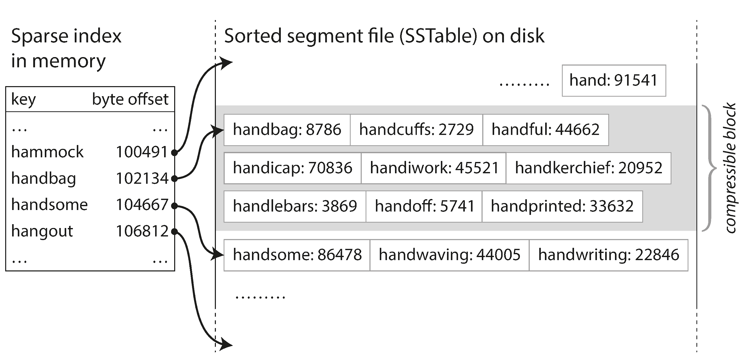
LSM‑Tree Write & Read Paths
Notes:
Here's how the mem table looks (at the left) See how now its sparse, it only contains a small subset of keys When searching for "handoff" it'll find the closest key in the mem table "handbag" (remember the mem table is a tree now not a hashmap) The segment containing handbag is visited then binary search is used to find the "handoff" entry using the sort order of the keys

Slide 13
From Logs to Sorted String Tables (SSTables)
Constraint: each on‑disk segment is sorted by key & contains no duplicates.
Merge becomes linear file merge à la mergesort (Figure 3‑4).
Sparse in‑memory index: just 1 pointer per block, binary search inside block..
Basis for LevelDB, RocksDB, Cassandra & HBase.
Notes:
[Read Slide first]
Since the in memory index is sparse this can feasibly support billions of keys

Slide 14
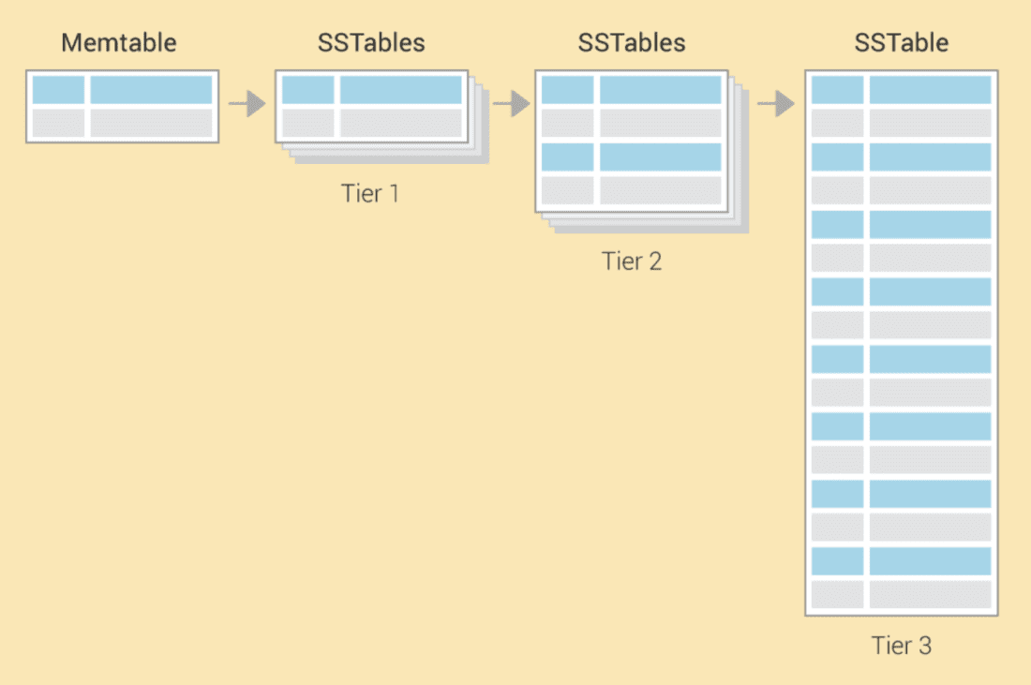
Size Tiered Compaction
Notes:
Size-tiered compaction (STC) favors fast writes because:
New data is written as-is: Incoming writes are first buffered in memory (memtable), then flushed to disk as immutable SSTables without needing immediate merging with existing data.
Delayed compaction: Compaction only happens after several similarly sized SSTables accumulate, so the system avoids frequent merges and allows disk writes to proceed quickly.
Fewer immediate I/O operations: Since compaction is less aggressive, it reduces write amplification in the short term — the data isn’t rewritten multiple times right away.

Slide 15
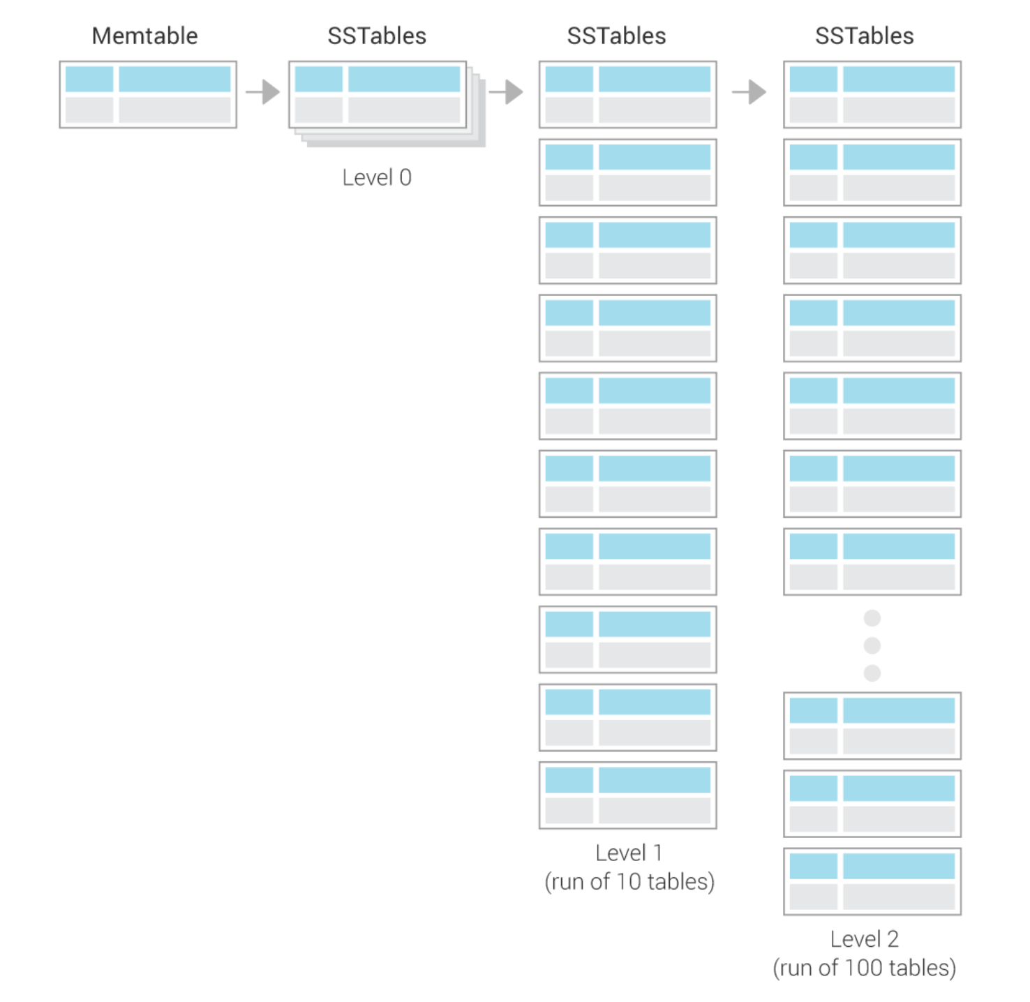
Level Tiered Compaction
Notes:
Performance benefits of Levelled Compaction
Low read amplification – Below L0, SSTables are non-overlapping, so a point lookup or range scan touches at most one file per level (≈ log₁₀ N files total). Keys are laid out contiguously across a small, ordered set of files, so a scan streams sequentially instead of hopping between overlapping files.
Predictable latency – Fixed per-level size caps bound the worst-case number of files per query, giving steadier read performance than size-tiered schemes.
Efficient range scans – Fully sorted, non-overlapping runs let large sequential reads stream through just a handful of contiguous files.
Space reclamation – Each merge discards obsolete or deleted keys early, keeping space amplification modest.
Sequential I/O for compaction – Although data is rewritten more often than in size-tiered compaction, the merges are mostly sequential writes, preserving solid sustained write throughput.

Slide 16
LSM‑Tree Write & Read Paths
Write: record → WAL → memtable (balanced tree) → flush to new SSTable.
Read: consult memtable → Level‑0 SSTables → … → oldest level; Bloom filters prune misses.
Compaction strategies: size‑tiered vs. leveled (RocksDB default).
Bloom Filters save IO for negative look‑ups (key definitely not present).
Performance: high sequential write throughput; read latency depends on compaction health.
Notes:
Let’s trace a byte through an LSM engine like RocksDB.
Step 1️⃣:
The client issues a Put.
We synchronously append it to a write‑ahead log (WAL) for durability,
then insert it into the in‑memory memtable.
Step 2️⃣:
When the memtable is full, we flush it to disk as an SSTable at Level‑0.
Step 3️⃣:
Background threads gradually compact small, overlapping SSTables
into larger ones—forming Levels 1, 2, 3, and so on.
There are two major compaction strategies:
Levelled compaction keeps total size bounded
Size‑tiered compaction minimises rewrite traffic
A read request works like this:
First, check the memtable
Then scan Levels youngest → oldest
To avoid worst‑case IO on non‑existent keys,
each SSTable has an associated Bloom filter.
→ If the filter says no, we skip that file entirely.
Proper tuning is crucial—
If compaction falls behind, both read latency and space usage can explode.
That’s why monitoring pending compaction bytes is operations‑critical.

Slide 17
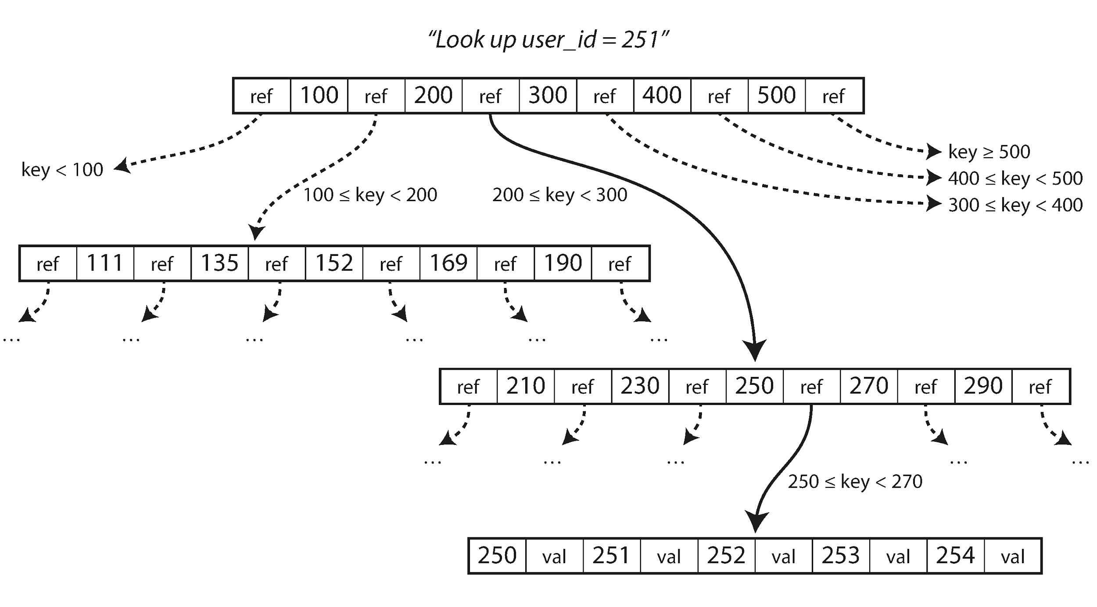
B‑Tree Anatomy Figure 3-6
Notes:
Invented in 1970, the B‑tree is the venerable workhorse of relational databases.
Figure 3‑6 shows a simple three-level B‑tree.
The root page acts like a traffic cop:
→ ‘Keys < 200 go left, 200–300 go next,’ and so on.
Each child page repeats this pattern until we reach a leaf page,
which holds the actual rows or row pointers.
A single 4 KB page can store hundreds of keys,
so the branching factor is massive.
That means even a trillion-row table can be navigated in just four hops:
→ Root → Level 1 → Level 2 → Leaf —
→ That’s only four disk seeks.
Pages are addressed by physical page number,
so pointers remain valid even if the file is moved on disk—
→ A huge win for stability and pointer safety.
Every data modification touches just one leaf page,
(except during rare splits),
which makes single-row reads and writes both fast and predictable.

Slide 18
B‑Tree Anatomy
Page‑oriented: fixed 4 KB blocks mirror disk sector size.
Branching factor ≈ hundreds ⇒ 3–4 levels fits terabytes (Figure 3‑6).
Each interior page stores separator keys & child pointers; leaves hold primary data or row refs.
Root → child pointers followed via binary search per page.
Balanced by design: depth O(log n).
Notes:
Read slide

Slide 19
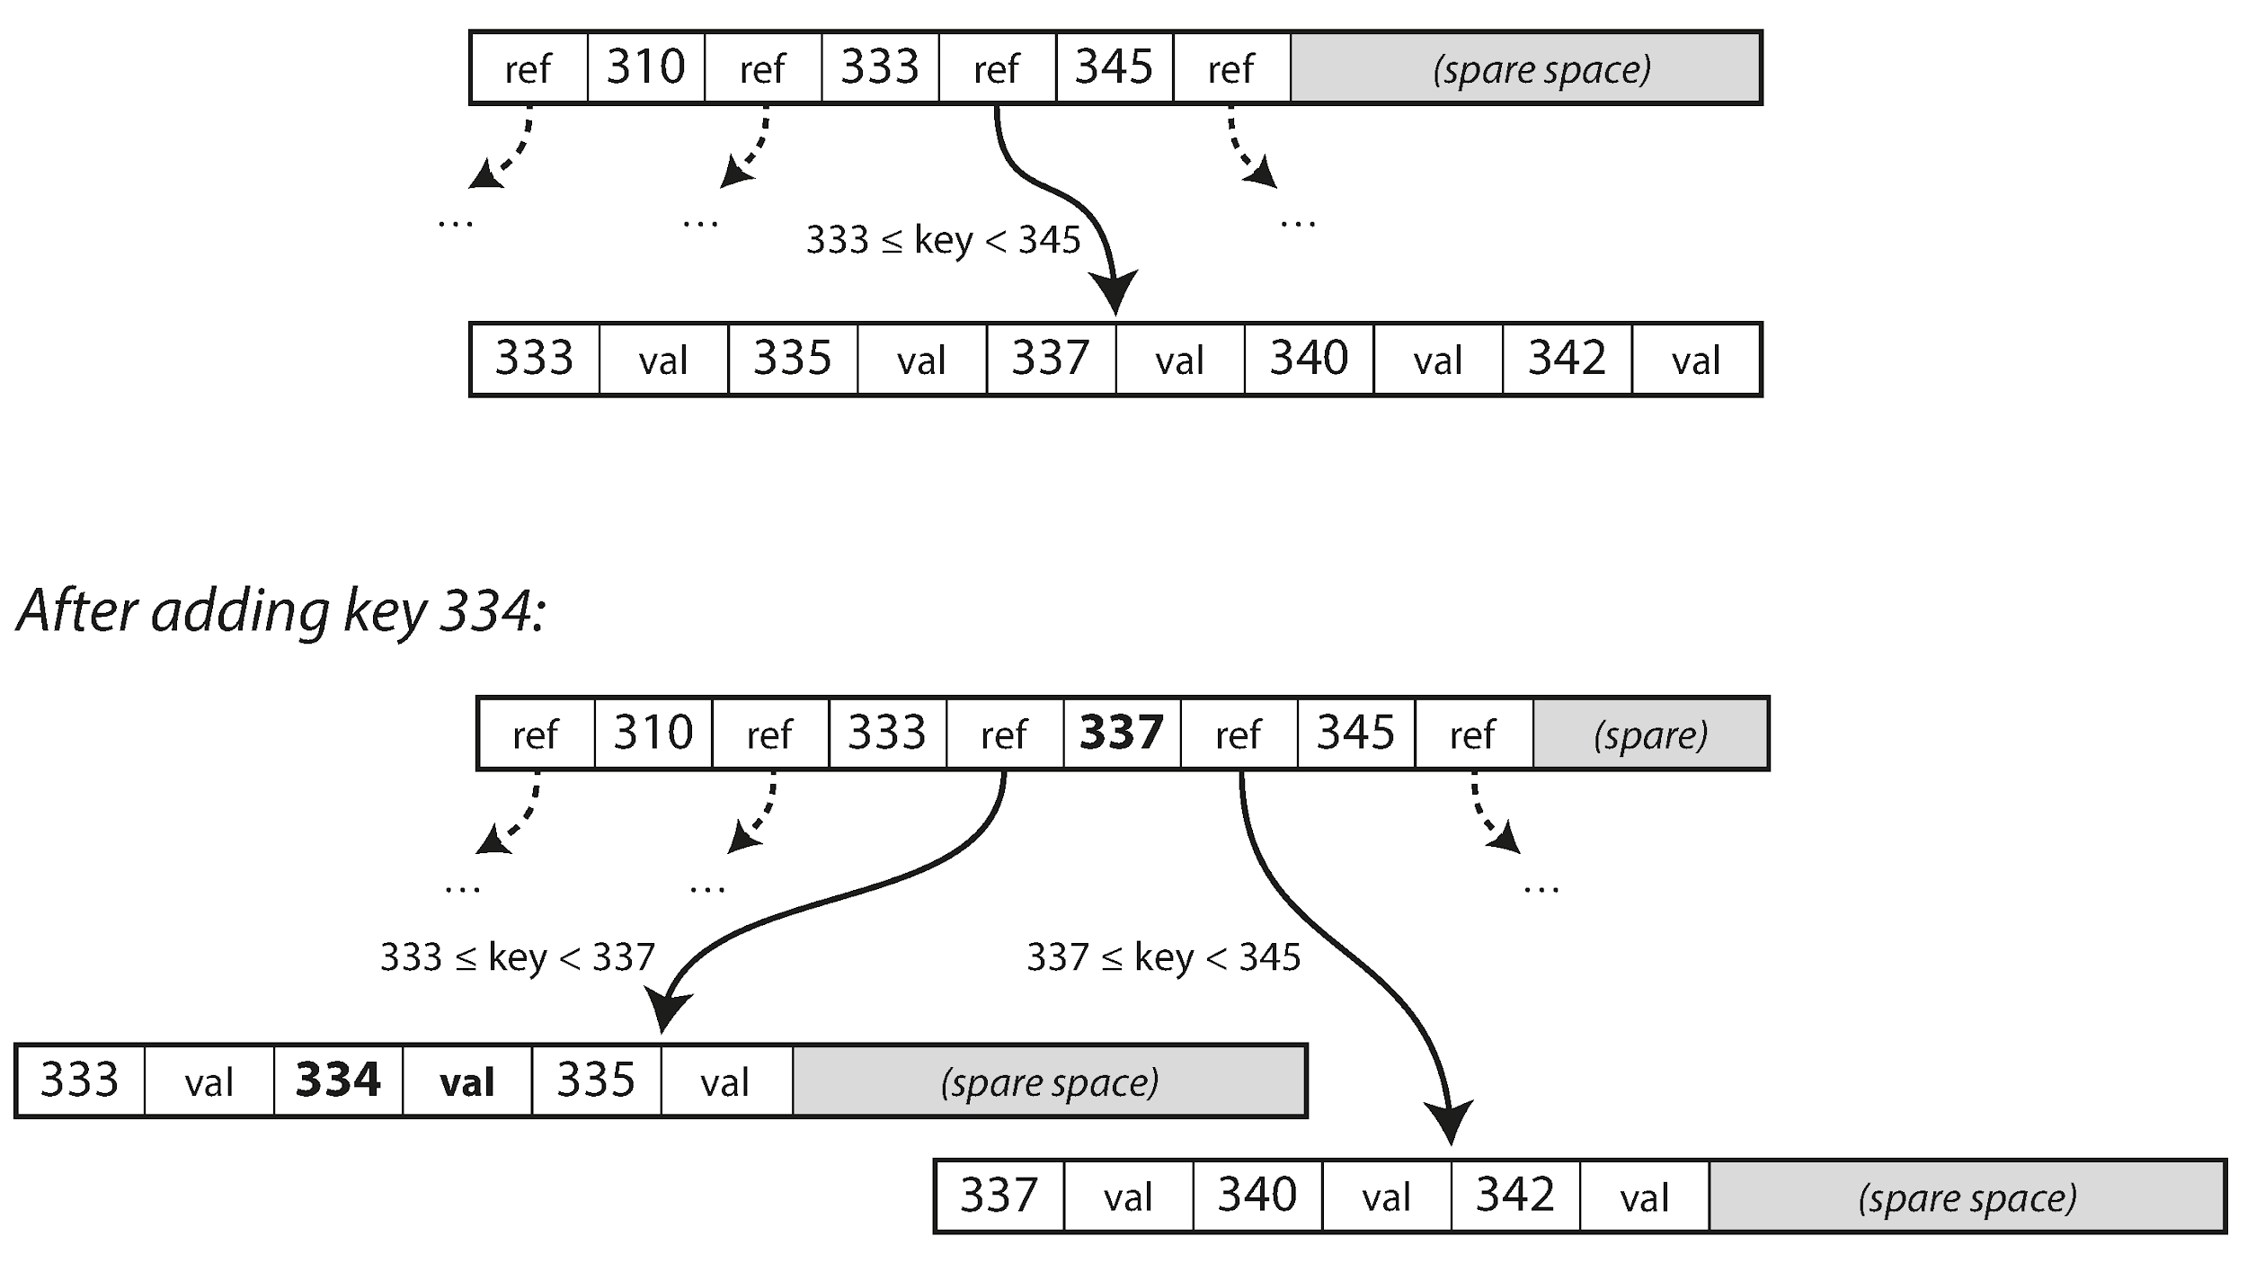
Page Splits & Balancing Figure 3‑7
Notes:
When you insert the key 333 into the example B‑tree,
the destination leaf page is already full.
As Figure 3‑7 shows, the tree handles this gracefully:
It allocates a fresh 4 KB page
Copies half the key‑value pairs to the new page
And updates the parent node with a new separator key—337 in the diagram
This is the only time when page addresses change—
and even then, it’s done in a strict top‑down order
→ So other readers never see an inconsistent path through the tree.
But now we have an atomicity problem:
What if the server crashes after writing only two of the three modified pages?
Classic B‑tree engines solve this with a write-ahead log (WAL):
Before any page is dirtied, we append a redo record to the WAL
On restart, the log is replayed to restore consistency
Some modern engines, like LMDB, take a different approach:
→ They use copy‑on‑write pages, so the old version stays intact
→ Until the new root is safely fsynced
This ensures durability without ever leaving the structure in an invalid state.

Slide 20
Page Splits & Balancing
Insert into a full leaf triggers a split (Figure 3‑7).
Half the keys stay; half move to new sibling; parent gets new separator key.
Guarantees trees stay balanced; depth only grows when root splits.
Deletions may cause merge or redistribution to prevent under‑full pages.
Pages overwritten in‑place ⇒ require WAL + careful crash recovery.
Notes:
Read Slide

Slide 21
Optimisations & Variants
Prefix compression & key abbreviation pack more separators per page.
Clustered indexes store the full row in leaf pages; secondary indexes reference primary key.
Copy‑on‑Write B‑trees (LMDB, ZFS) avoid in‑place overwrite and ease snapshots.
Layout tweaks place sequential leaf pages adjacently on disk for faster range scans.
Emerging research: fractal trees borrow LSM buffering to reduce random IO.
Notes:
Over forty years of engineering have squeezed surprising performance from B‑trees.
One key optimization is prefix compression:
→ We store just enough bytes to distinguish adjacent keys.
→ This often doubles the branching factor, reducing tree height and disk seeks.
A clustered index stores the entire row in the leaf pages,
→ This guarantees locality for sequential scans.
By contrast, a heap file + secondary index setup:
→ Trades that locality for cheaper updates and less page churn.
Some modern engines flip the traditional model entirely.
Systems like LMDB, btrfs, and ZFS treat pages as immutable
→ and apply copy‑on‑write instead of in-place updates.
This makes:
Crash recovery trivial
And enables low‑cost snapshot isolation—handled directly by the file system
Finally, academia continues to innovate:
→ Fractal trees are one such example.
They attach small write buffers to internal nodes,
→ So writes are batched, much like mini‑LSM segments
This cuts random I/O by an order of magnitude—
bringing together the best of both B‑trees and LSM design.

Slide 22
LSM vs. B‑Tree – When to Choose Which?
LSM excels at write‑heavy workloads: sequential disk pattern ⇒ low write amplification.
B‑tree offers more predictable read latency: 1 lookup → 1–3 page reads.
LSM write amp rises with aggressive compaction; B‑tree write amp from page + WAL rewrites.
Transactional locking integrates naturally with B‑trees; trickier on multi‑segment LSMs.
Benchmark with your data & query mix—rule‑of‑thumbs only go so far.
Notes:
The community sometimes frames LSM vs. B‑tree as a zero‑sum contest.
But in reality, each has its sweet spots.
LSM trees turn random updates into sequential log appends,
which gives them staggering ingestion rates—
→ For example, Facebook’s RocksDB can exceed 100 MB/s per core on SSD.
But that performance comes at a cost:
Every byte is rewritten multiple times due to compaction.
A read might need to touch many files across levels.
B‑trees, by contrast, update pages in place.
One insert touches:
The write-ahead log (WAL)
And exactly one 4 KB page— → plus the occasional page split.
This keeps space overhead low
and often serves point reads in a single trip to storage.
On spinning disks, that single seek advantage is decisive.
On SSDs, the performance gap narrows, but still matters.
Concurrency control is also simpler in B‑trees:
Each key lives in exactly one page
So range locks attach neatly.
LSMs, by contrast, may hold multiple versions of the same key across levels,
which complicates isolation semantics.
Bottom line:
Prefer LSMs for event streams, time-series data, and write-heavy workloads
Prefer B‑trees for mixed read/write OLTP workloads that demand low tail latency

Slide 23
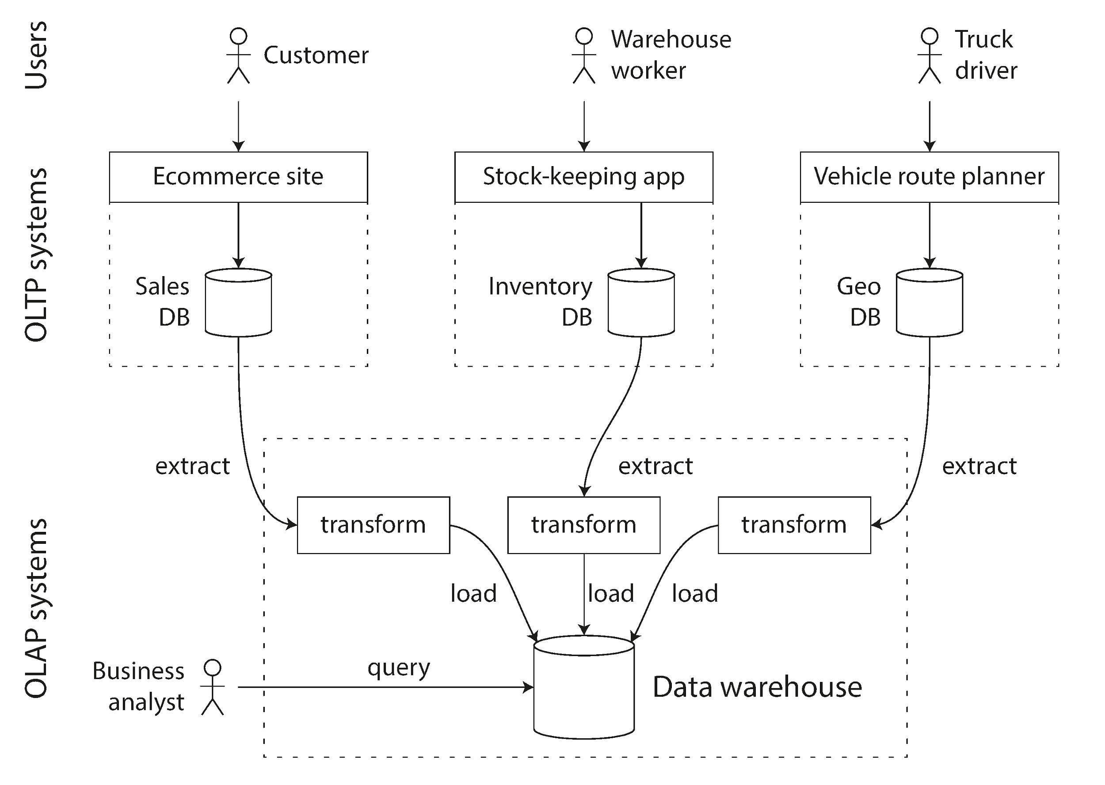
OLTP vs. OLAP Landscape Figure 3‑8
Notes:
We’re about to pivot from row‑oriented OLTP engines
to column‑oriented analytic engines—
but first, we need some context.
In a large enterprise, there are dozens of mission‑critical OLTP systems:
→ e‑commerce checkout, inventory, routing, HR, and more.
Running ad hoc 5‑minute analytical queries on those live systems
would devastate latency for paying customers.
So ops teams erect a data warehouse wall.
Figure 3‑8 shows the common pattern:
ETL jobs—either nightly or streaming— → Extract data from OLTP systems → Transform it into a cleaner schema → And Load it into the warehouse
Because the data warehouse is read‑only, it can focus on:
Throughput
Heavy compression
And parallel scans
→ No need to worry about hot writes or transactional isolation.
Engineers often underestimate this architectural decoupling,
because modern cloud services (like BigQuery or Snowflake)
hide the plumbing.
But understanding this split is key to choosing the right storage layout
for analytics vs. operations.

Slide 24
OLTP vs. OLAP Landscape
OLTP: latency‑sensitive, point queries, gigabytes → terabytes, high concurrency.
OLAP / Data Warehouse: batch or interactive analysis, scans, terabytes → petabytes.
ETL copies data from many OLTP systems into warehouse (Figure 3‑8).
Separation protects transactional latency & allows warehouse‑specific optimisations.
SQL common to both, but under the hood engines diverge.
Notes:
Read slide

Slide 25
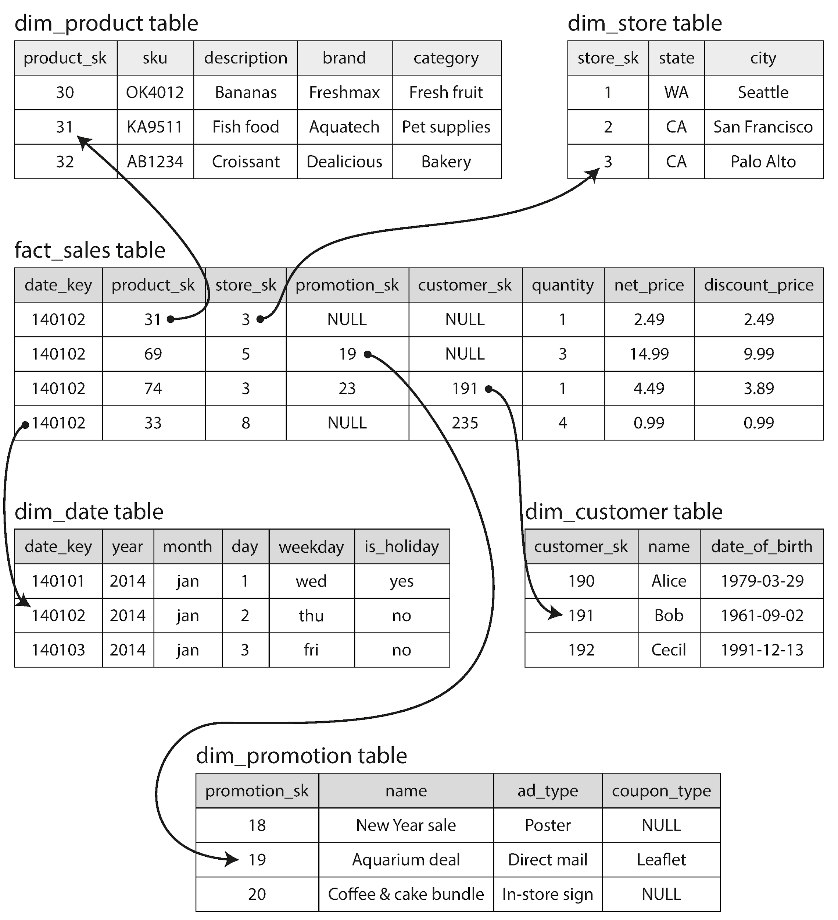
Star & Snowflake Schemas
Notes:
Unlike OLTP models, which mirror application objects,
data warehouses use a highly regular star schema.
At the center is a giant fact table—
It records every low-level event—
→ Literally trillions of rows at Walmart scale.
Surrounding it are the dimension tables,
which hold descriptive attributes like:
Product details
Store metadata
Dates, customers, promotions
Analysts write queries that aggregate facts along these dimensions,
like:
→ sum(quantity) by product category and weekday
Figure 3‑9 illustrates the pattern:
The fact table sits in the center
Dimension tables radiate outward—like a star
You can take it further by snowflaking the schema:
→ For example, splitting the product dimension into brand and category subtables.
But many teams stick with the straightforward star schema
because BI tools and analysts understand it intuitively.
Keep this schema pattern in mind
as we dive into column storage—
→ The fact table is where compression brings the biggest payoff.

Slide 26
Star & Snowflake Schemas
Fact table: billions of *events* (sales, clicks); foreign keys to dimension tables.
Dimensions: who/what/where/when/why; millions of rows each.
Star schema places dimensions around central fact table (Figure 3‑9).
Snowflake schema further normalises dimensions into sub‑tables.
Denormalise judiciously to balance query simplicity vs. ETL complexity.
Notes:
Read slide

Slide 27
Column‑Oriented Storage Layout
Fact table stored column‑by‑column, not row‑by‑row (Figure 3‑10).
Query touches 4–5 columns → read only those files.
Columns for same row kept in same order index, enabling reassembly when needed.
Run‑length & dictionary compression thrive on uniform column values.
Apache Parquet, ORC, Google Dremel underpin modern data lakes.
Notes:
Scan-heavy analytic queries rarely need every attribute in a row.
Example 3‑1 in the book shows this:
It groups by weekday and category, and sums quantity—
→ That’s just 3 out of 100 columns.
But in row-oriented storage, we still have to:
Pull all 100 columns off disk
Parse them
Then discard 97 that the query doesn’t use
That’s incredibly wasteful.
Column-oriented layouts solve this elegantly:
They physically co‑locate all values of the same column,
so the engine can issue one large sequential read per column—
→ Much more efficient.
Figure 3‑10 shows the contrast between:
Row storage: where all columns are interleaved together
And a column store: where each attribute has its own block
Because rows stay in the same order across all columns,
we can lazily stitch rows together—only when a query really needs it.
There’s another huge benefit: compression.
Uniformity within a column allows for:
Integer dictionaries
Bit-packing
Delta encoding
These techniques can shrink storage by 10–100×.
Open formats like Parquet and ORC bring this to the Hadoop ecosystem.
Commercial systems like Vertica push it even further.

Slide 28
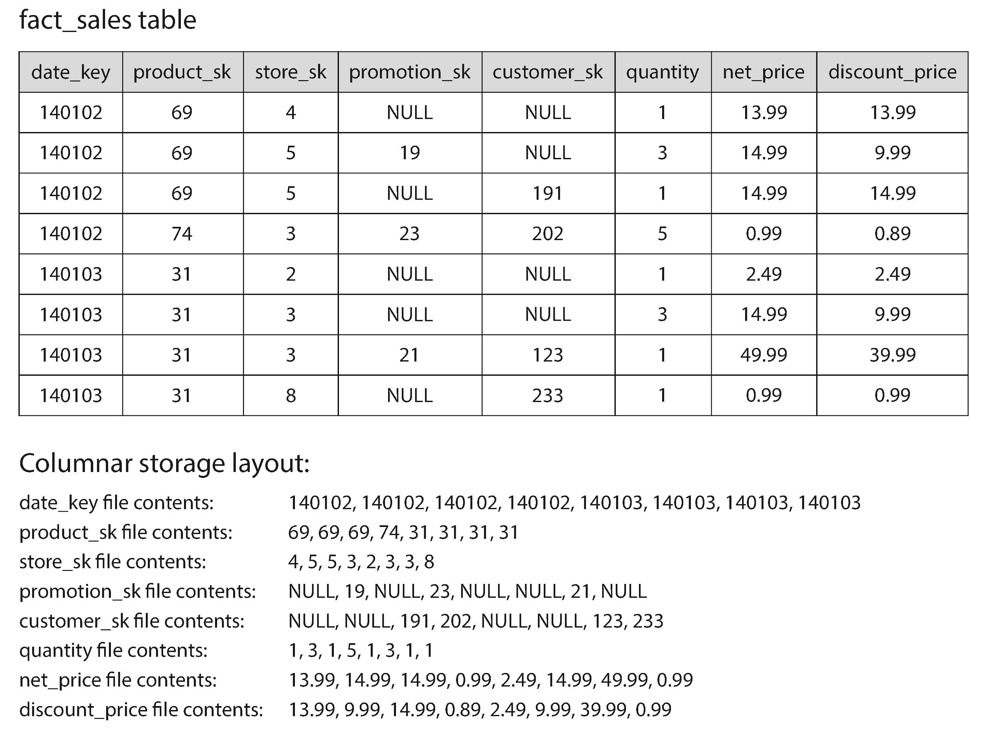
Bitmap & Other Column Compression
Notes:
Compression isn’t just about saving space—
It’s also about CPU and I/O efficiency.
Figure 3‑11 zooms into a single column: product_sk.
Out of billions of sales, there are only about 100,000 distinct products.
So the engine builds one bitmap per product:
→ A 1-bit marks the rows where that product appears.
→ Since each row usually refers to a different product, each bitmap is mostly zeros.
That’s where run-length encoding (RLE) comes in:
→ Long gaps of zeros are collapsed into single-byte instructions.
Now, say an analyst runs a query like:
WHERE product IN (30, 68, 69)
Instead of scanning the column:
The engine loads just three compressed bitmaps
Performs a bitwise OR on them
And instantly gets the qualifying row IDs
And because the operation happens directly on the compressed bitmaps,
→ There’s no need to decompress first
Now add:
SIMD instructions
Cache‑friendly, branch‑free loops (aka vectorised execution)
…and suddenly, a column store can scan billions of rows per second—
→ Even on a laptop.

Slide 29
Bitmap & Other Column Compression
Few distinct values ⇒ bitmap encoding shines (Figure 3‑11).
Separate bitmap per value; run‑length compress sparse bitmaps.
Bitwise AND / OR operations answer filters without touching fact rows.
Vectorised execution keeps hot loops inside CPU L1 cache.
End result: petabyte scans at interactive latencies.
Notes:
Read slide

Slide 30
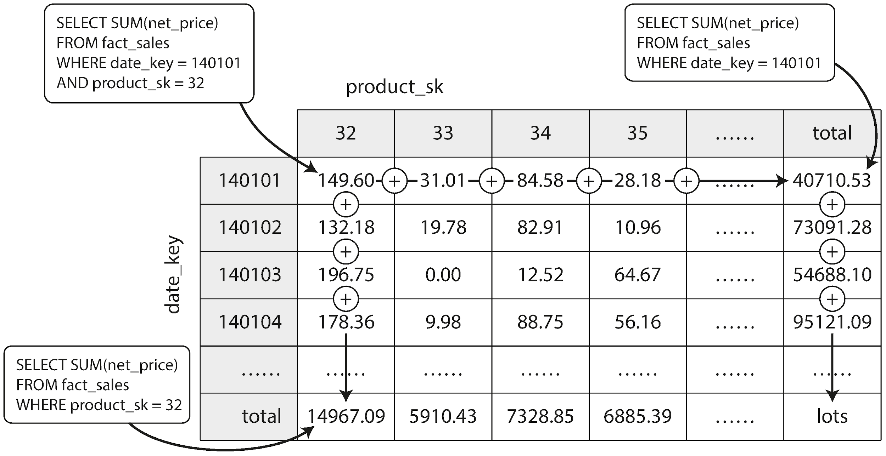
Data Cubes & Materialised Aggregates Figure 3‑12
Notes:
Analysts love slicing and dicing their data—
That’s the heart of exploratory analysis.
The same fact table might be grouped by store today,
and by promotion tomorrow.
To make these explorations instant, we use a structure called a data cube.
A data cube pre‑aggregates the raw facts along several dimensions.
In Figure 3‑12, we start with date and product as the cube’s axes.
→ Each cell contains the sum of net_price for that intersection.
From there, we can:
Collapse the product axis to get totals per date
Or collapse date to get totals per product
Behind the scenes, the data warehouse maintains this cube as a materialised view.
When new sales arrive—for example, yesterday’s data—
→ The ETL job just increments the relevant cube cells,
→ Without needing to touch every historical row again.
Now—cubes aren’t free:
They increase ETL time
They take up extra storage
And they can become stale if you need ad‑hoc dimensions
But for stable dashboards, they offer incredible speed and responsiveness.

Slide 31
Data Cubes & Materialised Aggregates
Re‑computing heavy aggregates each query wastes CPU; cache them!
Materialised view / cube stores pre‑aggregated metrics along multiple dimensions.
Figure 3‑12 shows a 2‑D cube (date × product) with SUM(net_price).
Cubes trade write cost & storage for sub‑second analytic queries.
Modern engines rebuild cubes incrementally to handle streaming data.
Notes:
Read slide

Slide 32
Summary & Takeaways
Know your workload: OLTP ≠ OLAP ⇒ choose engine accordingly.
Log‑structured (LSM): sequential writes, high throughput, compaction complexity.
B‑trees: single‑seek reads, mature concurrency control, predictable latency.
Column stores & compression transform scan cost for analytics.
Storage design is a series of trade‑offs—there is no silver bullet.
Notes:
We’ve travelled quite a distance—
From a toy Bash key‑value store
to petabyte‑scale data warehouses.
And along the way, we’ve seen a key theme emerge:
The shape of the workload dictates almost every design decision inside a storage engine.
If you need to ingest millions of metrics per second,
a log‑structured engine with leveled compaction and a Bloom filter
will absolutely outperform a B‑tree.
If you need to service a shopping cart lookup in 2 ms,
or run multi‑row transactions,
then the B‑tree’s single-page update-in-place is your best friend.
If you’re an analyst waiting on yesterday’s numbers,
a column store with vectorised execution—
and maybe even a pre‑computed cube—will feel like magic.
The good news?
Modern systems often embed multiple engines:
PostgreSQL supports heap + B‑tree and columnar extensions
Spark can query Parquet
MySQL can swap storage engines depending on your needs
Ultimately, the key skill isn’t just knowing the tools—
It’s knowing which trade-offs matter for your problem,
and learning to turn the right knobs.

